Slide 1
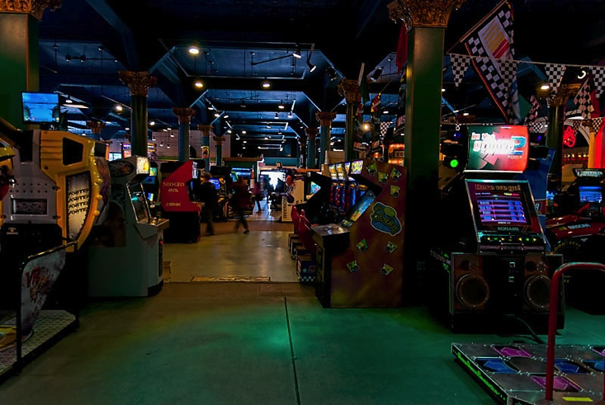
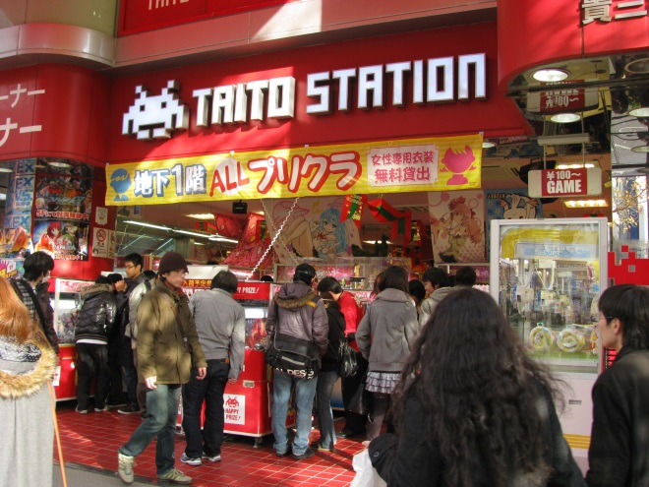
A Comparative Study of Game Centers in the US and Japan
http://www.dragonslairfans.com
http://commons.wikimedia.org
Shawn Clark
Advisors:
Dr. Yoshiko Saito-Abbott
Dr. Chikaomi Takahashi

Slide 2
Outline
1. Significance of the Study
2. Research Questions
3. Research Background
A. History of Arcades in the US
B. History of Arcades in Japan
C. How have Consoles affected game centers?
4. Research Method
5. Research Findings
6. Conclusion
7. Limitations of the Study
8. References
9. Acknowledgements

Slide 3
Significance of the Study
During my study abroad I noticed that game centers were popular among all age groups in Japan, and they always seemed quite busy.
This reminded me of the arcades that I played in when I was growing up in the US, which have since become rather scarce.
After visiting a number of game centers in Japan, I wanted to try and understand why game centers remained popular in Japan, while nearly disappearing from American society.

Slide 4
Research Questions
Why are game centers (arcades) so prevalent in Japan while they are on the decline in the US?
What is the appeal of playing at a game center instead of at home?
What are the most popular games in each culture’s arcade and why?

Slide 5
Research Background
Arcades in the US
From pinball to video games
1983 industry crash
What made video games popular?
Arcades in Japan.
Pinball and early video games were imported.
Taito creates Space Invaders.
Popularity of Pac-Man and Donkey Kong
How have console games affected the arcade industry?
The industry started out with equal focus on home consoles and arcade cabinets.
American and Japanese social structures

Slide 6
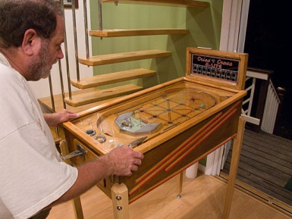
Arcades in the US
The first arcades featured pinball machines.
The first successful coin-operated machine was Baffle Ball, created by David Gottlieb in 1931.
Bally introduced a cash-payout pinball machine, which led to a city-wide ban in New York in 1942.
(June, 2013)
The first computer game, OXO, was created by Alexander Douglas in 1952 for his Ph.D. thesis.
Computer Space, the first commercial video game, is created by Nolan Bushnell and Ted Dabney in 1971; however, it was too complicated to attain much popularity.
(Dillon, 2011)
http://www.pinballnews.com

Slide 7
Arcades in the US (2)
Pong was created in 1972, to huge success. Part of this success was due to the simple controls and instructions for the game.
The industry crashes in 1983, due to numerous factors.
Nintendo releases the Nintendo Entertainment System (NES) in the US in 1985, prompting an industry focus on home consoles rather than arcade cabinets
(Dillon, 2011)

Slide 8
Main Reasons for the 1983 Crash
Home computer wars
There were many companies in the new industry, but they could not compete with Commodore’s aggressive marketing.
Further development of home consoles
Over-estimating the market
After success in 1982, many companies expected the market to absorb around 60 million cartridges for home consoles.
Total industry production was about 120 million cartridges.
Poor Quality Products
Companies were left with lots of unsold inventory.
Poor public image
Parents begin blaming video games for their children’s faults
“video games encourage young people to waste money, energy, and valuable time”
Questionable content of games, usually violence
(Dillon, 2011)

Slide 9
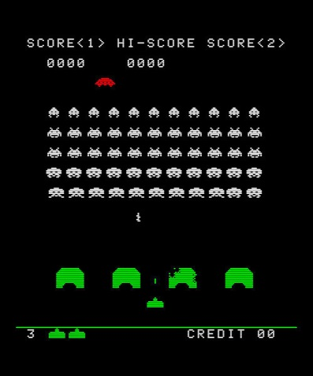
Arcades in Japan
1974: Namco distributes Atari’s coin operated games in Japan
1978: Taito’s game Space Invaders is so popular in Japan that it provokes a Y100 coin shortage.
Reasons for popularity:
First game to include animated characters, as well as a “high score” display.
(Dillon, 2011/Poole 2000)
http://3generations.eu

Slide 10
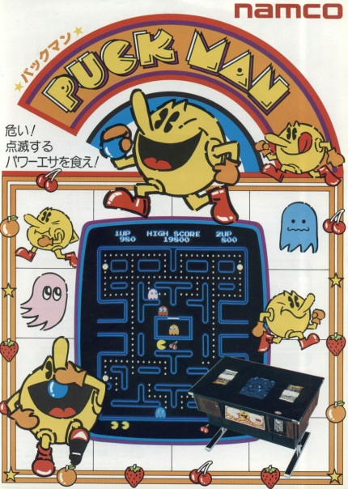
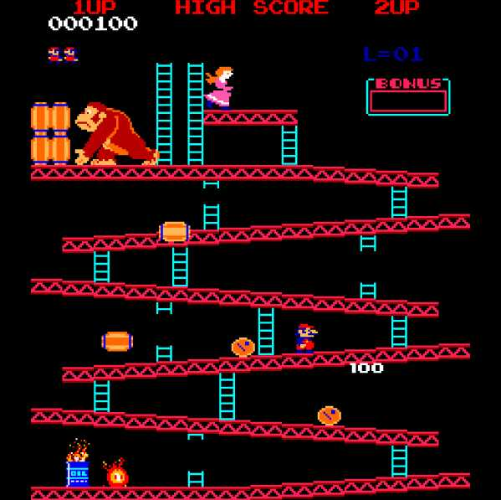
Arcades in Japan (2)
Namco creates Pac-Man in 1980, followed by Nintendo’s Donkey Kong in 1981
Both of these games introduced a new type of game, different from shooting games found in contemporary arcades.
These games used color graphics and cute characters-which led to popularity of the games and characters.
(Dillon, 2011)
http://www.computerhistory.org
supersmashbros.wikia.com

Slide 11
Impact of Home Consoles on Arcades
The first home console, the Magnavox Odyssey, was created in 1972, only one year after the first video game was created.
Atari began producing Pong for home use after the game’s success.
In January 1981, Commodore releases the VIC-20, the first color computer and the first to break one million units sold.
Commodore and many other companies were all competing in the same market, with largely the same products. Quality of the product was of paramount importance.
Nintendo released the Famicom in Japan in 1983, but waited for the US market to recover before releasing it as the NES in the US in 1985, shifting industry focus to home consoles in the US market.
(Dillon, 2011)

Slide 12
Cultural Reasons for Choosing Home Consoles or Arcades
“The very different fates that have befallen North American and Japanese arcades has to do with demographics and urban planning as much as differing gaming tastes between the two countries.”
“Japan’s train-based transportation culture makes it more inconvenient for those who live downtown to visit friends in the suburbs. In this kind of environment, downtown arcades became a convenient place for people to hang out and have fun before heading home for the night.”
Limited living and personal space in Japan compared to “giant suburban basements and rec rooms” where Americans play console games.
(Orland, 2012)

Slide 13
The Study
Research Questions:
Why are game centers (arcades) so prevalent in Japan while they are on the decline in the US?
What is the appeal of playing at a game center instead of at home?
What are the most popular games in each culture’s arcade and why?

Slide 14
Research Method
Research Participants
52 University Students
30 American students (17 male, 13 female)
22 Japanese students (8 male, 14 female)
Research Instruments
Online Survey
English Survey
Japanese Survey

Slide 15
Research Question 1
Why are game centers (arcades) so prevalent in Japan while they are on the decline in the US?
Usage of Arcades from Childhood to Adulthood
Comparison of Time Spent in Arcades
Availability of Arcades
Comparison of Home Console Ownership
Frequency of Playing Consoles with Others

Slide 16
RQ1: Usage of Arcades from Childhood to Adulthood
As children, both American and Japanese students went to game centers more frequently than as adults.
Japanese students visit arcades more frequently as adults than Americans, though they tend to visit as rarely as once a month or once a year

Slide 17
RQ1: Comparison of Time Spent in Arcades
American students answered that they tend to stay in arcades longer than Japanese students. This trend applies as both adults and children

Slide 18
Availability of Arcades
From this data, American arcades are clearly in decline, while the majority of Japanese respondents are unsure of the state of arcades in the neighborhood.
However, the second-most popular response for the Japanese, “there are more arcades now” implies growth, or at least some health in the Japanese amusement industry.

Slide 19
RQ1: Comparison of Console Ownership
Based on this data, console ownership among college students is on a decline.
However, this may be to students growing up, moving out of their parents’ homes, and not being able to afford a new console of their own.

Slide 20
RQ 1: Frequency of Playing Games with Others on a Console
As children and as adults, Americans play console games with others more often.

Slide 21
How Console Games are Played with Others
How people play games together varies between Americans and Japanese. The two most popular methods for Americans are online or via WIFI connection, while Japanese prefer to physically meet and play on the same console. (multi-player)

Slide 22
Research Question 1 Findings
Though Americans do not visit arcades as often, they spend more time in them per visit.
It seems that Japanese students visit arcades for a shorter period of time, but more frequently than Americans.
Owning a game console and going to an arcade do not appear to be mutually exclusive, though owning a console is much more popular among Americans than Japanese students.
Surprisingly, Americans play console games with others more frequently than Japanese students. However, Americans tend to play online or over WIFI, while Japanese prefer playing with a friend or a group using the same console.

Slide 23
Enjoyment of Arcade Atmosphere
Surprisingly, American students agreed more strongly about playing around other people and watching people play games.
Japanese students indicated that they do not like noise nor the lights of arcades, while fewer Americans see noise and lights as unpleasant factors.

Slide 24
Negative Experiences at Game Centers
American Responses
[There are] bratty children and perverts starring [sic] at my body when playing dance games.
Some are pretty dirty. [I] was at one that literally had dried blood on the Air Hockey table.
[A] friend got knocked out by a person.
There’s bullies and one [sic] there was a shooting
Japanese Responses
It was too loud and smelled strongly of cigarette smoke.
At night there are shady people (like delinquents or bikers) at the game center.

Slide 25
Research Question 1-A Findings
Americans are not bothered by the lights of arcade machines, while 37% of Japanese respondents answered that they don’t care for them.
54% of Japanese respondents answered that they dislike the noise of arcade machines, compared to only 20% of Americans.
74% of Americans enjoy being around other people in an arcade setting, compared to only 32% of Japanese.
70% of Americans and 59% of Japanese answered that they enjoy watching others play games.
In addition to the maintenance of the machines, clean and safe environments are preferred by both Americans and Japanese. (I was surprised by some responses)

Slide 26
Research Question 2
What are the most popular games in each culture’s arcade and why?

Slide 27
Games Played by Men What are the most popular games in each culture’s arcade and why?
“Other” responses include “Driving/Racing games” and “Arcade Compilation Games” for American Men, and “Card Games” or “Do Not Go to Arcades” for Japanese.
American men play a wider variety of games at the arcade than Japanese.
“Crane Games” are most popular among Japanese men, while “Shooting Games” and “Dance Games” are equally popular among the American men surveyed.
Both American and Japanese men enjoy Dance/Music/Rhythm games equally.

Slide 28
Games Played by Women What are the most popular games in each culture’s arcade and why?
American women play a greater variety of games than Japanese women.
The most popular game at an arcade is “Picture Machines” for Japanese women, and “Shooting Games” for American women.
American women play “Crane Games” more often than American men. (23% for women, 12% for men)

Slide 29
Reason for Playing a Game
Japanese respondents stated that they chose games based on them being fun to play with other people, followed by the game’s ease of play. 13% wanted a game that “Looked interesting”, while other criteria were not very important.
American respondents were more concerned with how interesting the game looked, and the thrill of the game. 46% of respondents would consider whether the game could be played with others, and the game’s popularity proved the least important aspect to Americans

Slide 30
Research Question 2 Findings
Crane games are more popular among men in Japan than in the US.
American men and women play a greater variety of games than their Japanese counterparts.
Americans are primarily motivated by how interesting a game looks, while Japanese want to play games with their friends.

Slide 31
Conclusion
I found it interesting that Americans enjoyed playing games online or over WIFI, neither way requiring face to face interaction with another person.
Japanese still prefer to meet in person and play games together.

Slide 32
Limitations of the Study
Limited sample size.
Only focused on university students.
Limited demographics.

Slide 33
Future Study
I would like to choose the type of person who takes the survey. For example, I would focus on respondents who like video games or some similar trait.
Explore the inter-relation between game center culture and anime culture in Japan.
Is there enough interest to bring arcades back to the US? Or with the current cultural interest in Japan, would it be feasible to import game centers?

Slide 34
References
Arcades Still Making Noise in Japan (2009) Calgary Herald http://xerxes.calstate.edu/monterey/articles/record?id=FETCH-proquest_dll_16326250511
Arcade boom and Bust (2012) Chicago Tribune http://xerxes.calstate.edu/monterey/articles/record?id=FETCH-proquest_dll_27029065411
Ashcraft, Brian and Jean Snow. Arcade Mania: The turbo-charged world of Japan’s game centers. Kodansha USA. 2009
Blast from the Past (2008) Boston Globe http://xerxes.calstate.edu/monterey/articles/record?id=FETCH-proquest_dll_15170833911
Consalvo, Mia. 2006. “Console Video Games and Global Corporations: Creating a Hybrid Culture.” New Media & Society 8:117–37.
Dillon, Roberto. The Golden Age of Video Games A K Peters/CRC Press, FL 2011.
Have Arcades played Out? (2008) Chicago Tribune http://xerxes.calstate.edu/monterey/articles/record?id=FETCH-proquest_dll_14899394311
June, Laura. For Amusement Only: the life and death of the American arcade (2013) The Verge http://www.theverge.com/2013/1/16/3740422/the-life-and-death-of-the-american-arcade-for-amusement-only
Kent, Steven. The Ultimate History of Video Games. Three Rivers Press. 2001
Orland, Kyle. “Documentary Explores Why Japan’s Arcades Didn’t Die. http://www.wired.com/2012/04/100-yen-documentary/ 4/3/12. Accessed 5/2/14
Sega to Consolidate Regional Arcades (2002) Jiji Press English News Service http://xerxes.calstate.edu/monterey/articles/record?id=FETCH-proquest_dll_1035465951

Slide 35
Acknowledgements
Dr. Yoshiko Saito-Abbott
Dr. Chikaomi Takahashi
My parents: Teena Takata and Werner Clark
Michael Tyree
Alisa and Dave Paseman
Everyone who took my surveys
Japanese exchange students
My capstone class

